Slide 1



Multi-Extension Folder-Based Data Cleaning Project
Power Query

Slide 2

Managed cleaning & consolidation of multiple file formats (.csv, .txt, .xlsx, .pdf, .accdb)
01
Project Overview
02
Master folder with disorganized multi-year & multi-shift data
03
Challenges: inconsistent names, varied structures, format-specific issues
04
Goal: Unified Excel workbook with automated data pipeline

Slide 3

02
Project Objectives
Build scalable ETL (Extract, Transform, Load) process
Automate import & consolidation of mixed-format files
Standardize & normalize datasets
Apply format-specific cleaning techniques
Organize cleaned outputs into logical sections

Slide 4

01
Approach & Execution
Folder-Based Import Automation – Power Query Folder Connector
Power query
Auto-refresh when new files are added
File Extension-Specific Processing – duplicate queries for each type
Dynamic Transformation Logic – Invoke Custom Function
Complex Formats – Extracted tables from PDFs & imported Access tables
Data Cleaning – Standardized columns, data types, removed errors & invalids

Slide 5





01
Organized Final Output
Loaded cleaned data into separate Excel worksheets
Organized by file type for clarity
Single unified workbook ready for analysis

Slide 6


01
Key Skills Demonstrated
Folder-Based Automation – Batch import & refresh
Power query
Extension-wise Query Duplication & Filtering
Dynamic Parsing using Invoke Custom Function
Advanced Data Extraction – Handling PDFs & Access DB
Data Cleaning & Standardization – trimming, error handling
Structured Loading into Excel
Reusable, Scalable ETL Workflow

Slide 7
04
Tools Used
Microsoft Power Query – Automation & transformation
80%
Advanced Excel – Final structured output organization
60%

Slide 8
04
Project Outcome
01
Robust & reusable ETL solution for multiple formats
02
Automated refresh – instant updates with new files
03
Improved efficiency, accuracy, and consistency
04
Hands-on expertise in handling multi-format data

Slide 9

04
Repository Contents
80%
Multi-Extension Power Query Workbook.xlsx – Main Excel transformations
Project Documentation.pdf – Detailed steps & logic
/Raw Data Files – Original messy files
Presentation.pptx – Workflow presentation
Data Cleaning Report.png – Snapshot of results
Your Title

Slide 10




03
How to Use
Download or Clone repository
Open the Power Query Workbook & refresh
Place raw files in Raw Data Files folder
Review cleaned results in Excel worksheets

Slide 11



03
Future Enhancements
Integrate with Power BI Dataflows for cloud-based automation
Add validation rules for inconsistent data detection
Develop dashboard to visualize consolidated dataset

Slide 12
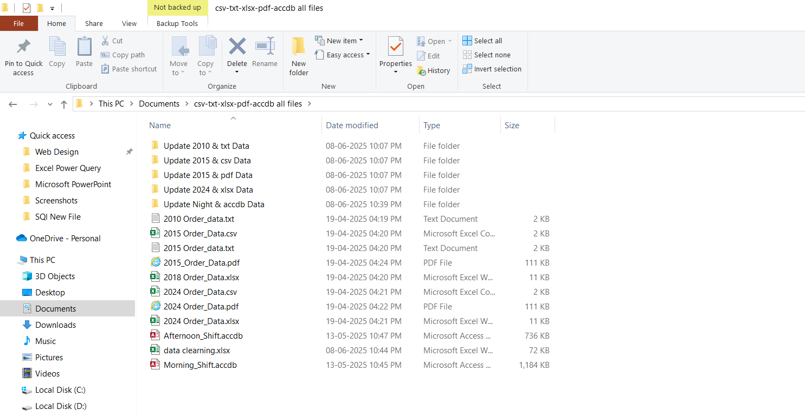
The complete set of source files encompassing all
relevant file extensions.

Slide 13
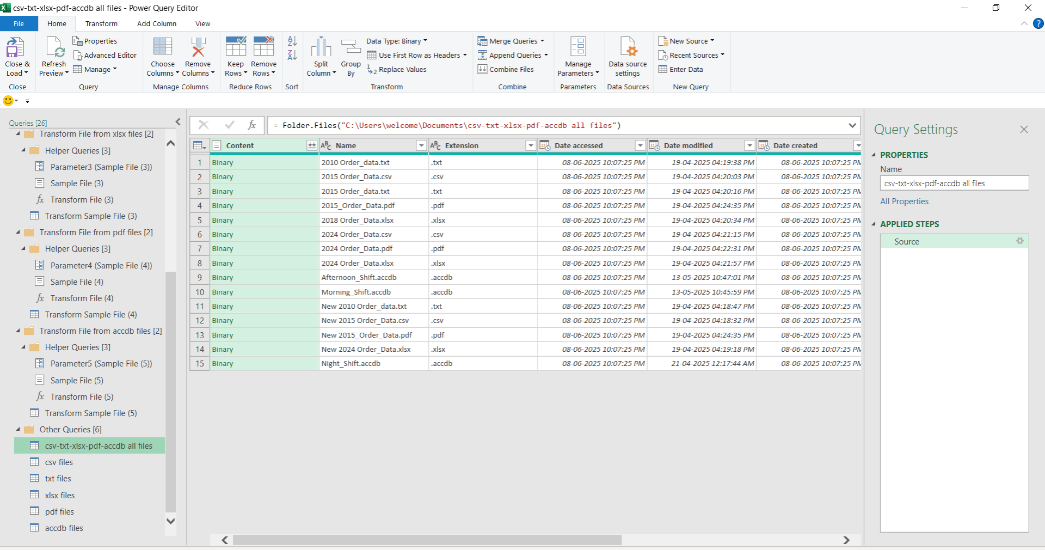
Raw Multi-Format Data Imported into Power Query
Editor for Cleaning and Transformation

Slide 14
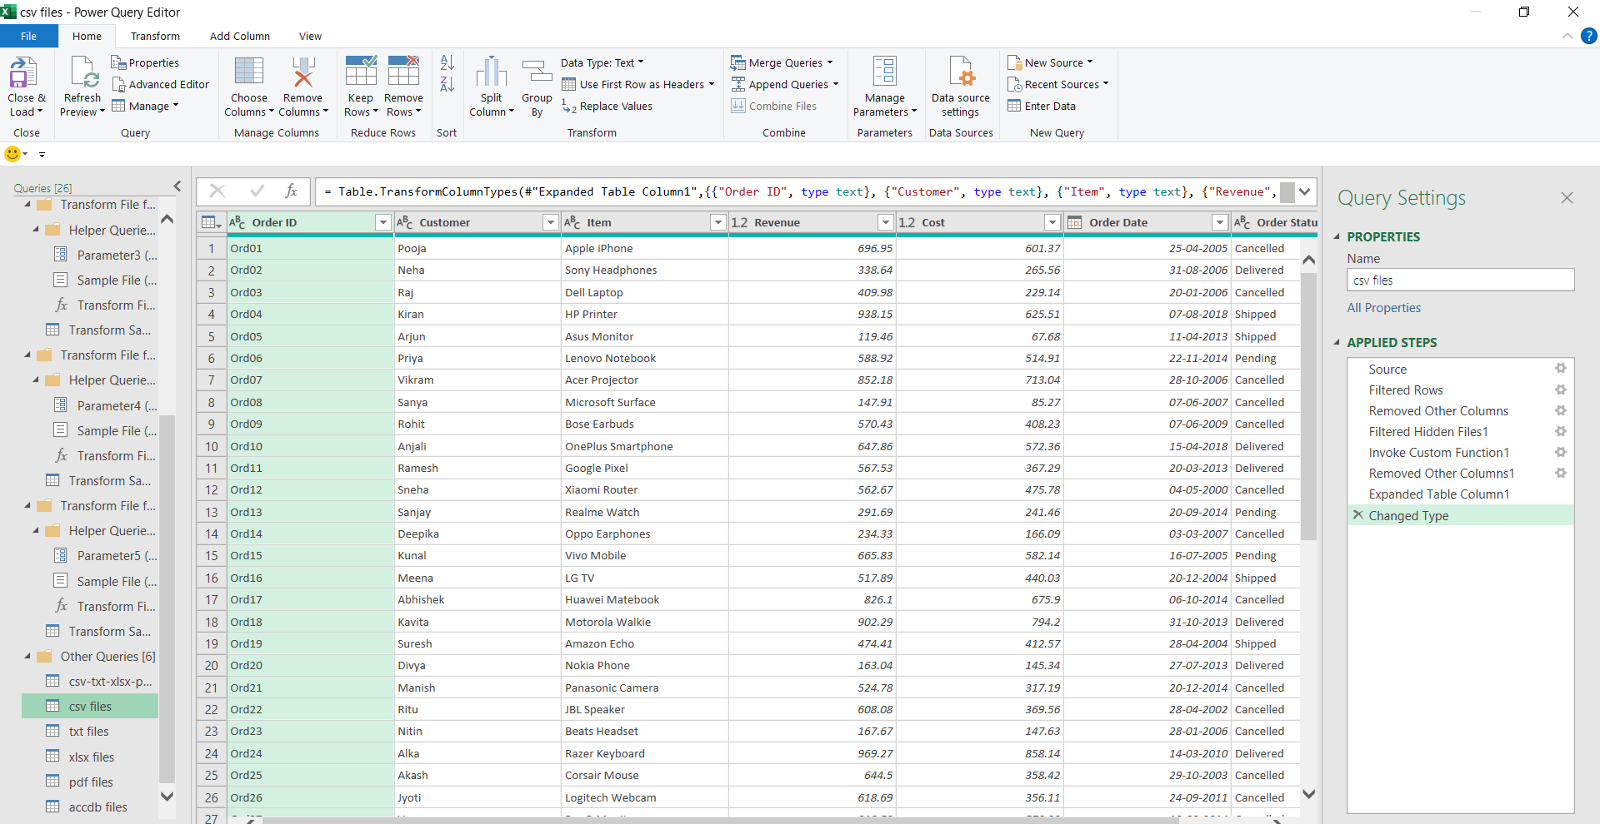
In Power Query Editor, after appending and cleaning all
the .csv files and applying the necessary steps.

Slide 15
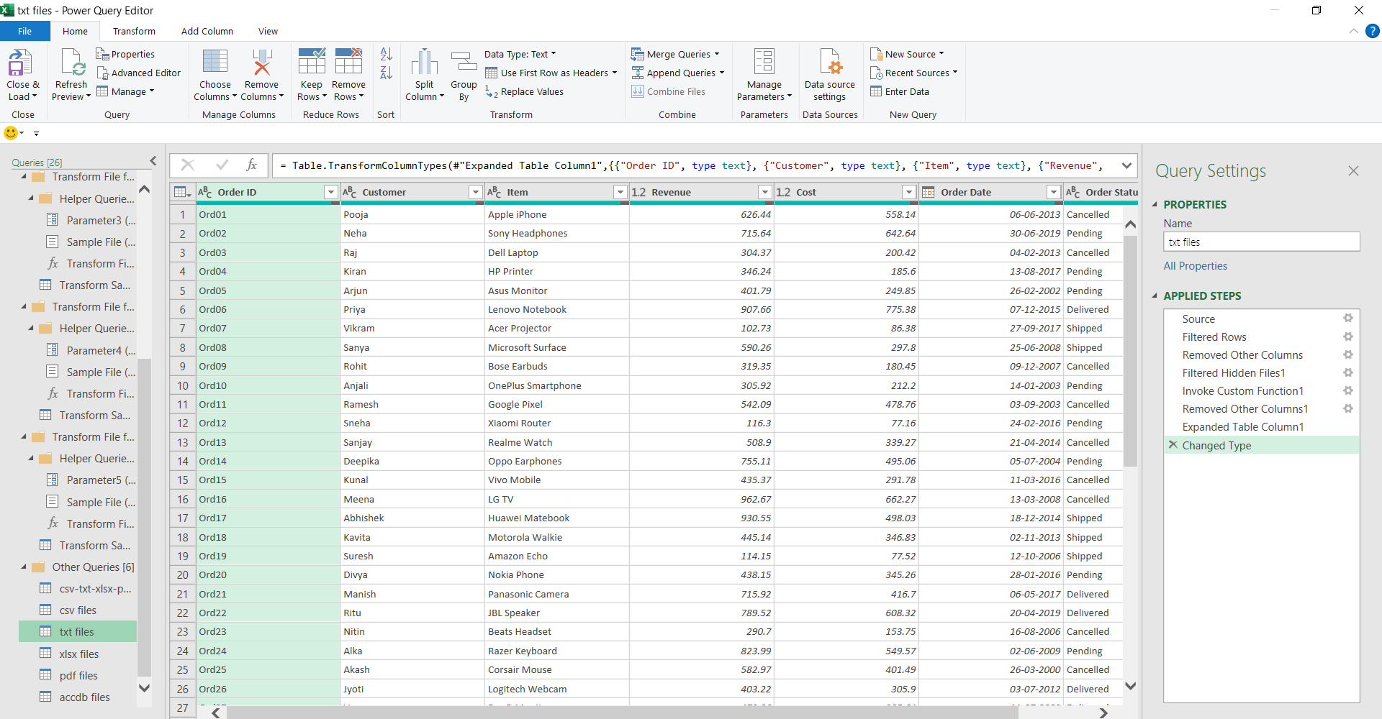
In Power Query Editor, after appending and cleaning all
the .txt files and applying the necessary steps.

Slide 16
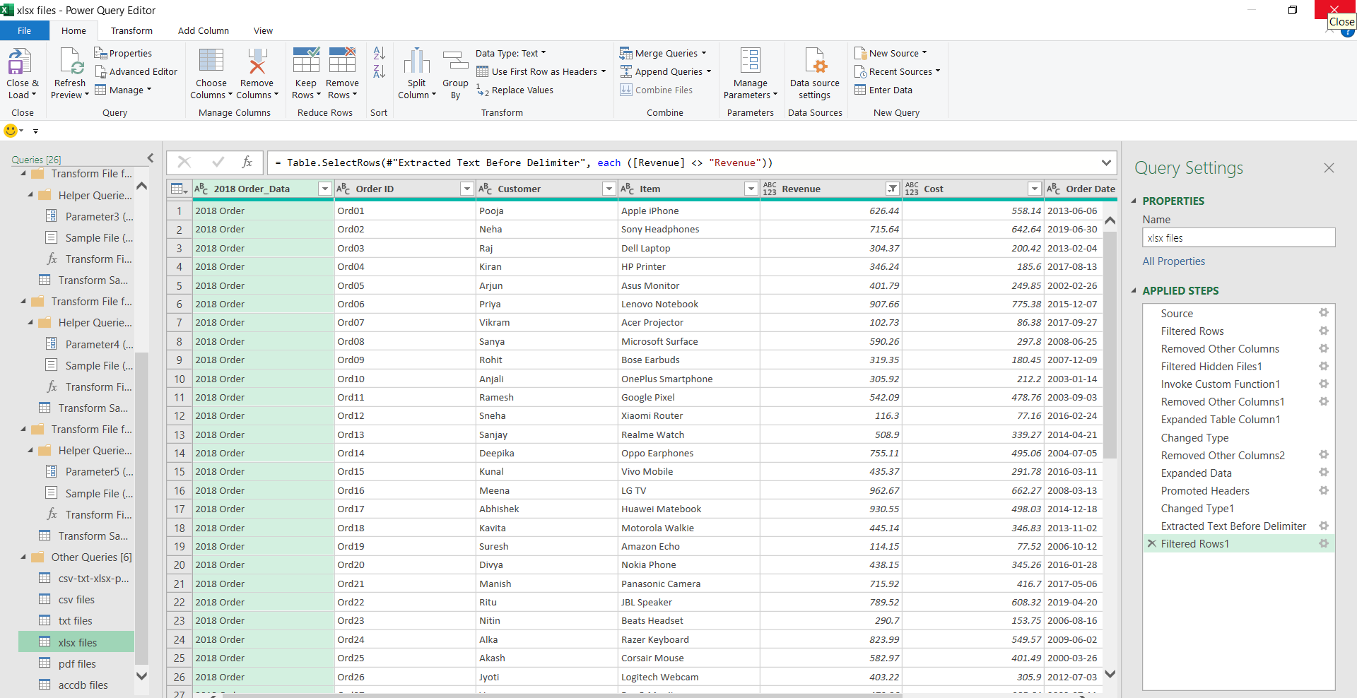
In Power Query Editor, after appending and cleaning all
the .xlsx files and applying the necessary steps.

Slide 17
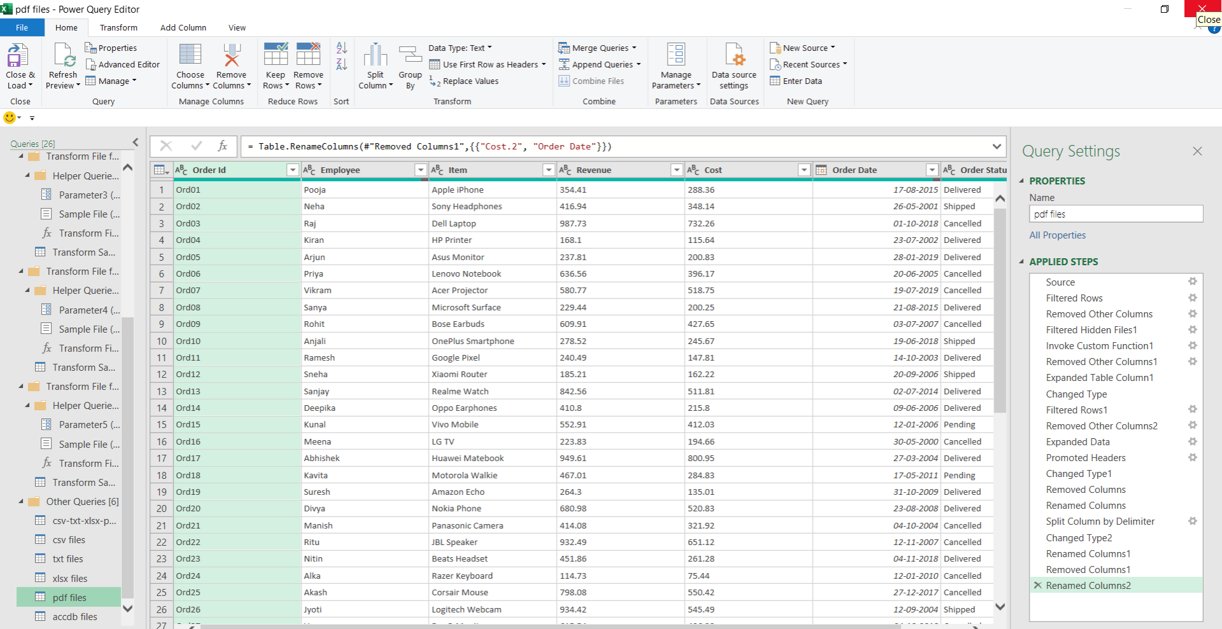
In Power Query Editor, after appending and cleaning all
the .pdf files and applying the necessary steps.

Slide 18
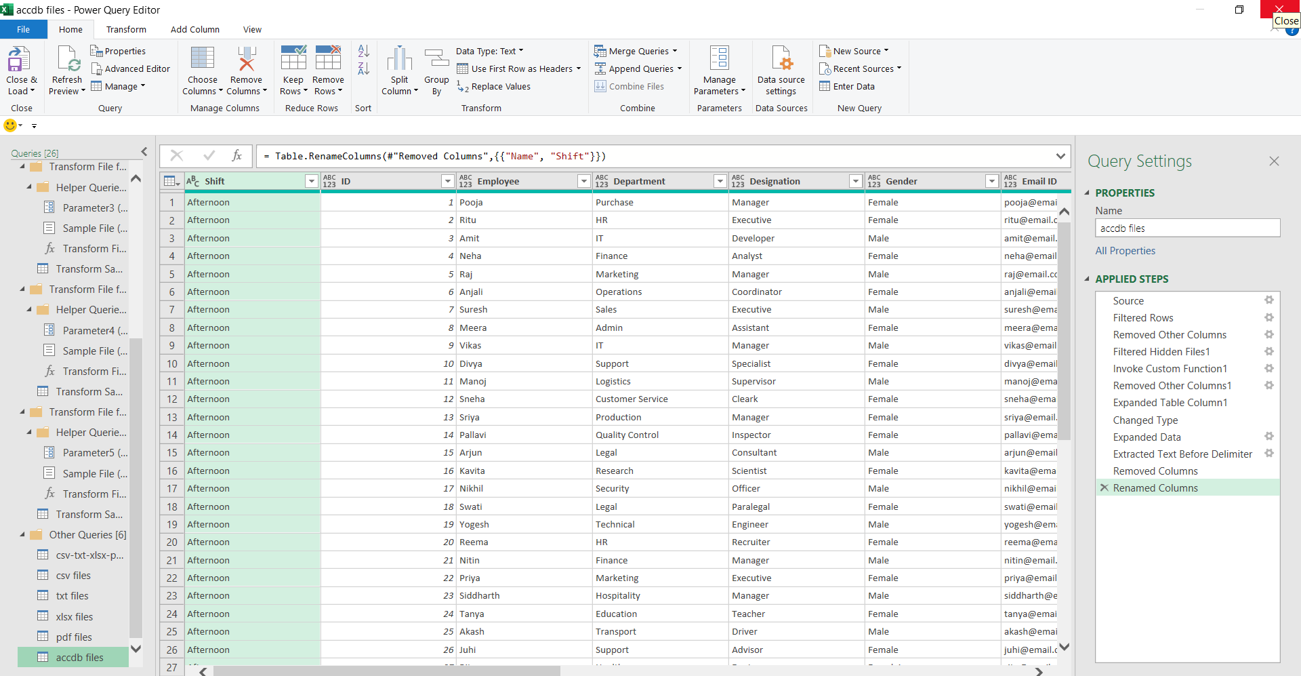
In Power Query Editor, after appending and cleaning all
the .accdb files and applying the necessary steps.

Slide 19
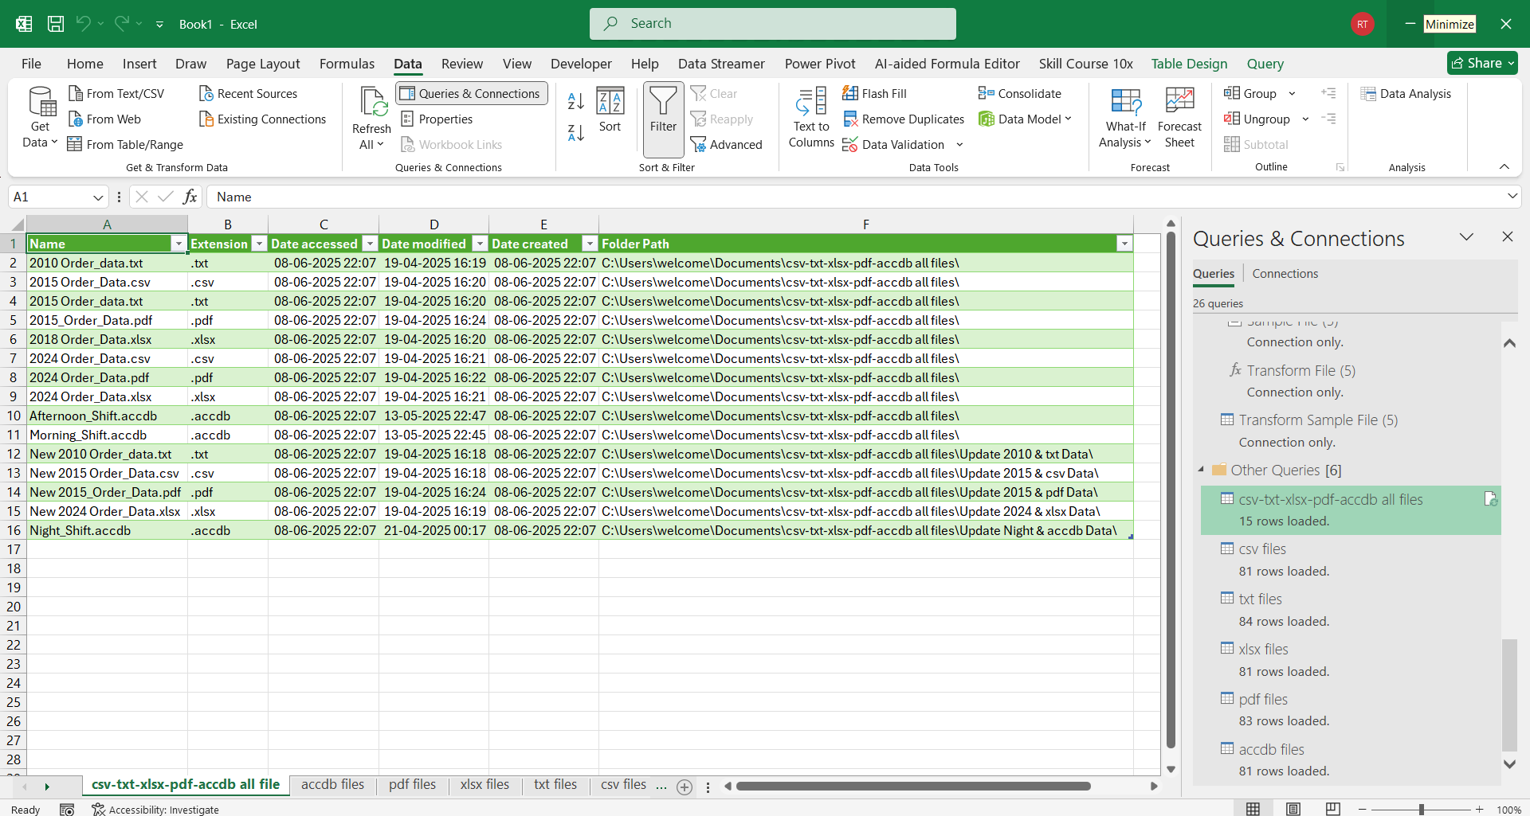
After the successful import of data from all files
into Excel..

Slide 20
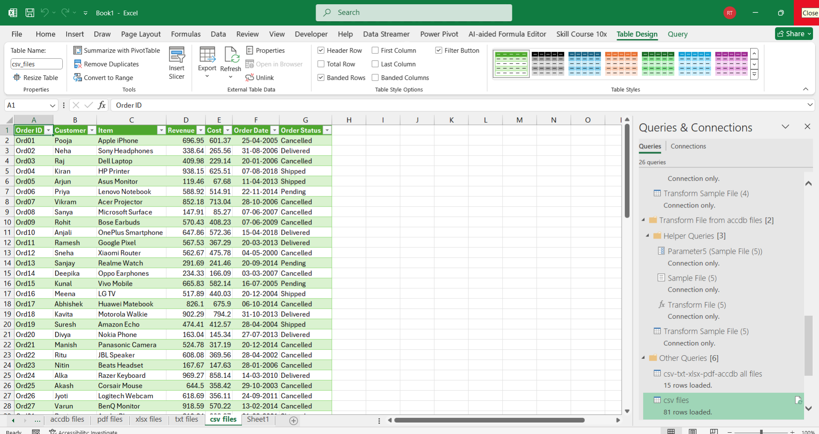
After the successful import of data from all .csv
files into Excel..

Slide 21

After the successful import of data from all .txt
files into Excel..

Slide 22
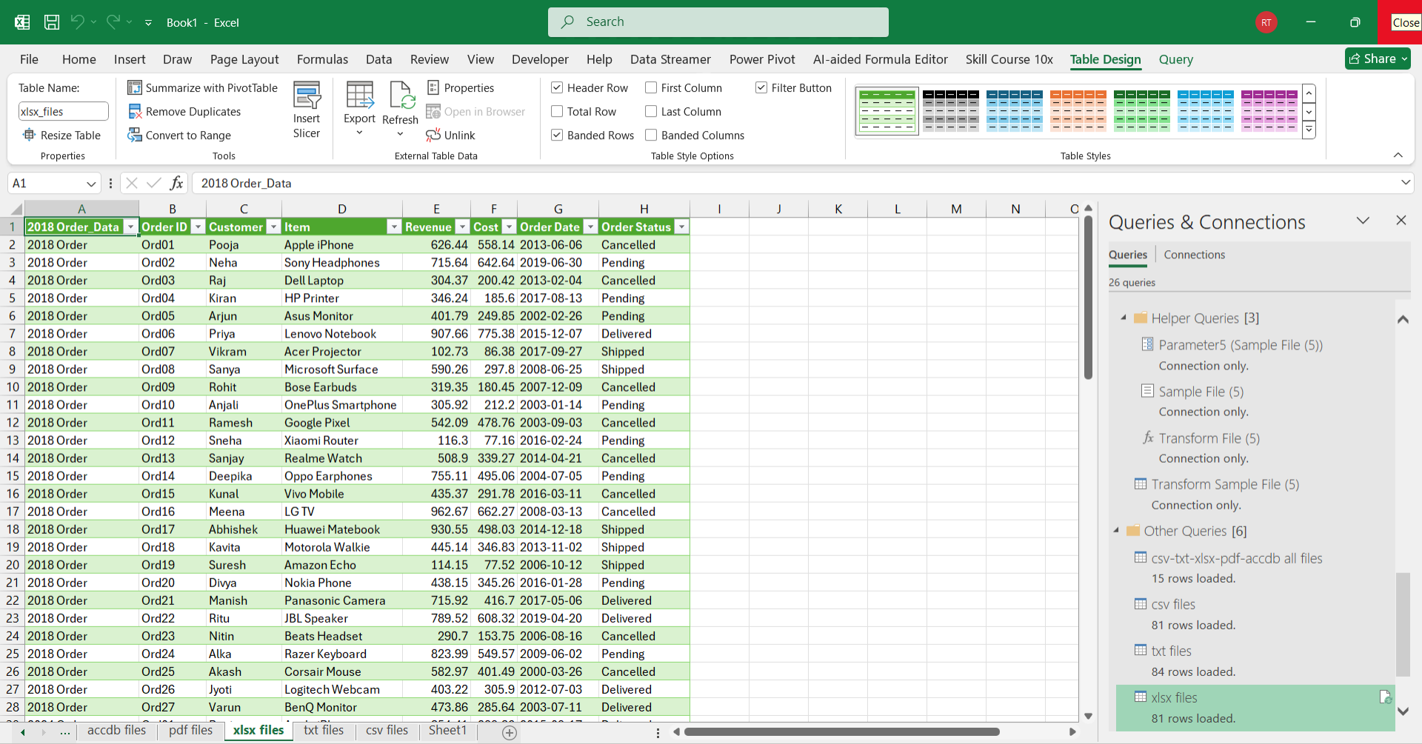
After the successful import of data from all .xlsx
files into Excel..

Slide 23
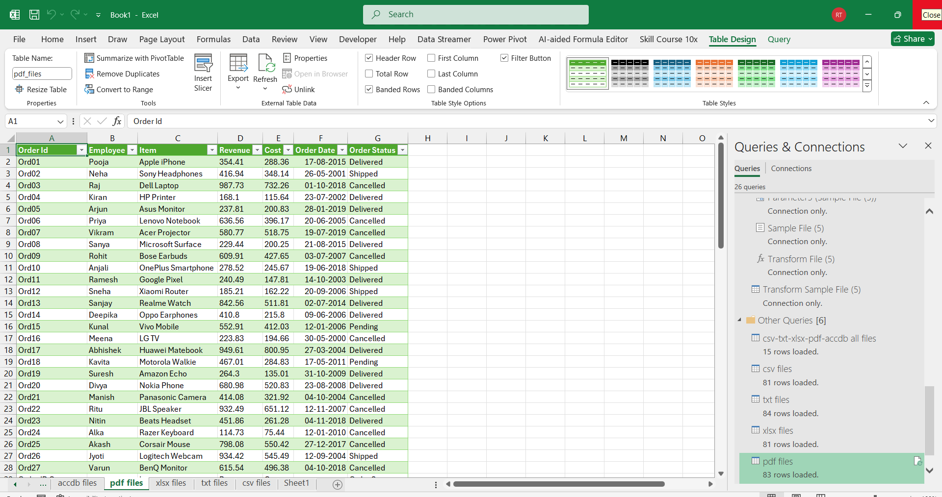
After the successful import of data from all .pdf
files into Excel..

Slide 24
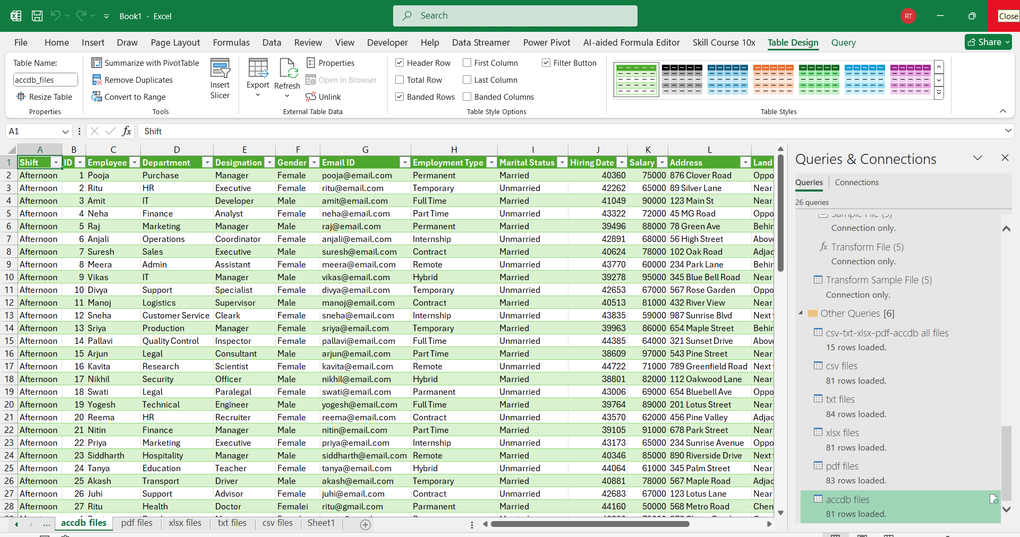
After the successful import of data from all .accdb
files into Excel..

Slide 25
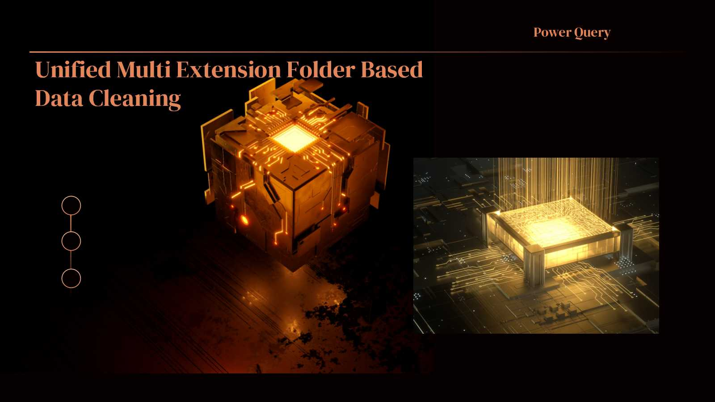
Project Overview

Slide 26
Thank You!
Every great presentation is complete with a great audience
— and that’s you!

